Slide 1
UPLIFT
Kunjan Praful Gala (001553294)
Sneha Swaroop (001572060)
Parth Joshi (001519059)

Slide 2
INTRODUCTION
We believe that the best place for a child to grow up is a safe and caring family. Thousands of teens in foster care are looking for the love, support, and encouragement that families provide throughout their lives—not just until they turn 18
Many children are deprived of basic necessities like education and healthcare. Sponsoring a child’s education and healthcare can make an impact in their life. There are plenty of good deeds to be done together and this contribution can do wonders!

Slide 3
PROBLEM STATEMENT
According to UNICEF, 15.1 million children have lost both parents (globally in 2015). 95% of them are over the age of five
There are many vulnerable children all over the world who need to be cared for and loved, who need a family to call their own
About 258 million children and youth are out of school, according to UIS data for the school year ending in 2018. The total includes 59 million children of primary school age, 62 million of lower secondary school age and 138 million of upper secondary age
There are up to 134,000 children with special needs awaiting permanent homes, according to the National Adoption Center, and the demand is growing

Slide 4
UPLIFT
Caring for children is a very broad action. It includes meeting the basic needs of food, clothing, shelter, education, medical care & love. It is making sure every vulnerable child knows that they have value
Our application is designed in a way that provides an easy solution to keep the track of children’s requirements
The purpose of our application is to provide a system where child is taken care of necessities like getting proper medical facilities, food, shelter and clothing and education until adopted

Slide 5
SERVICES PROVIDED BY UPLIFT
Medical services
Care coordination services
Financial services
Adoption Services

Slide 6


ADDITIONAL FEATURES
Email confirmation sent to sponsor to inform on their account status and payment receipt acknowledgement
Pie Graph OF SERVICES MANAGED BY OUR application showing who we serve Based on gender, age and special needs
Email confirmation sent to adopters to inform on their account status and on each phase of adoption process
ANALYSIS ON SERVICES MANAGED BY OUR APPLICATION

Slide 7
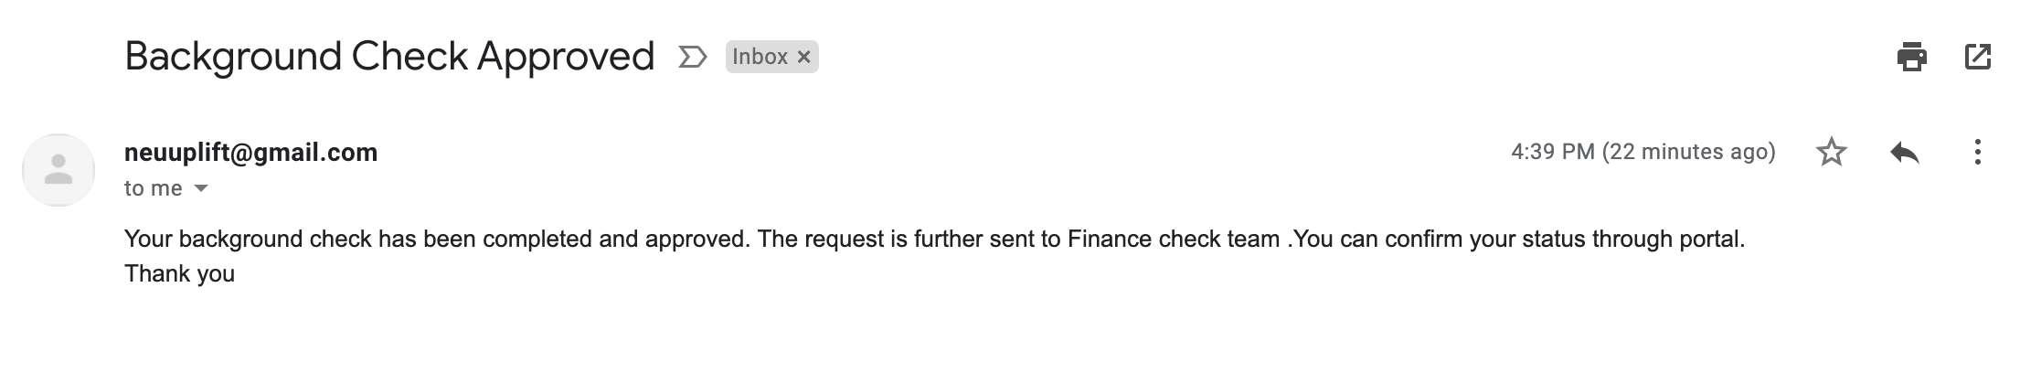

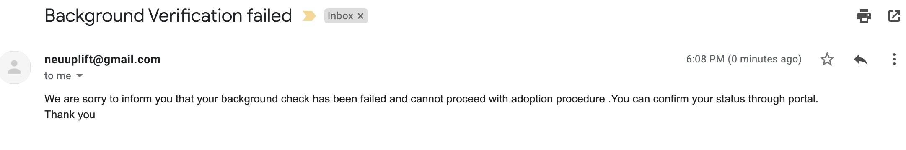
ADDITIONAL FEATURES – MAIL TO ADOPTER

Slide 8
ADDITIONAL FEATURES – MAIL TO SPONSOR

Slide 9
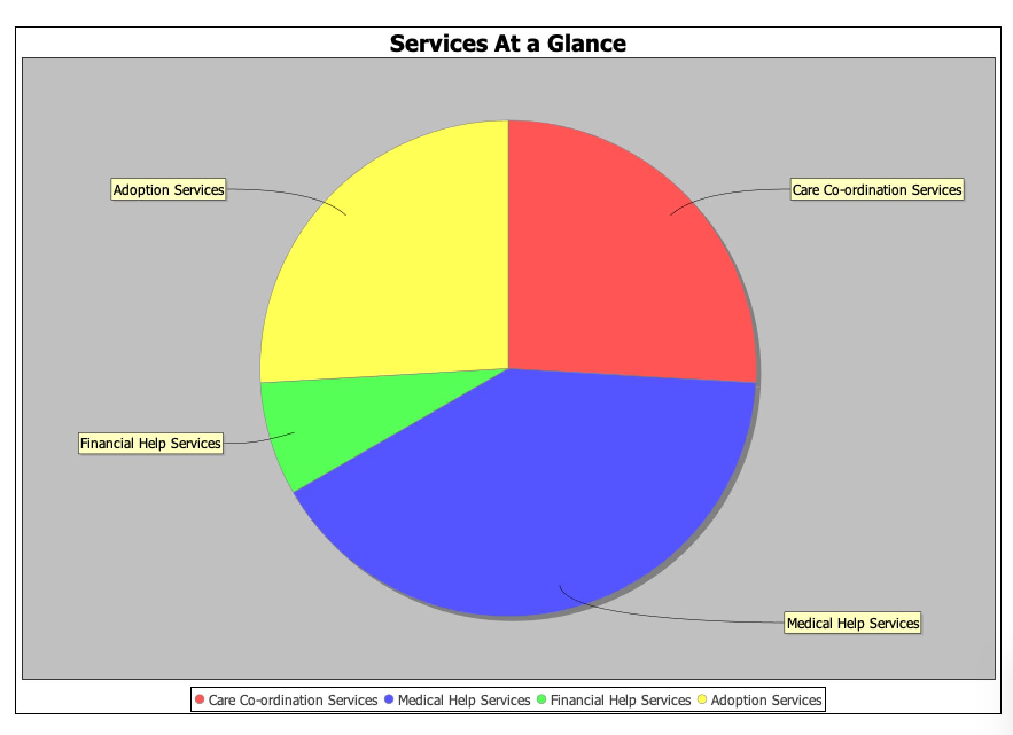
SERVICES AT A GLANCE

Slide 10
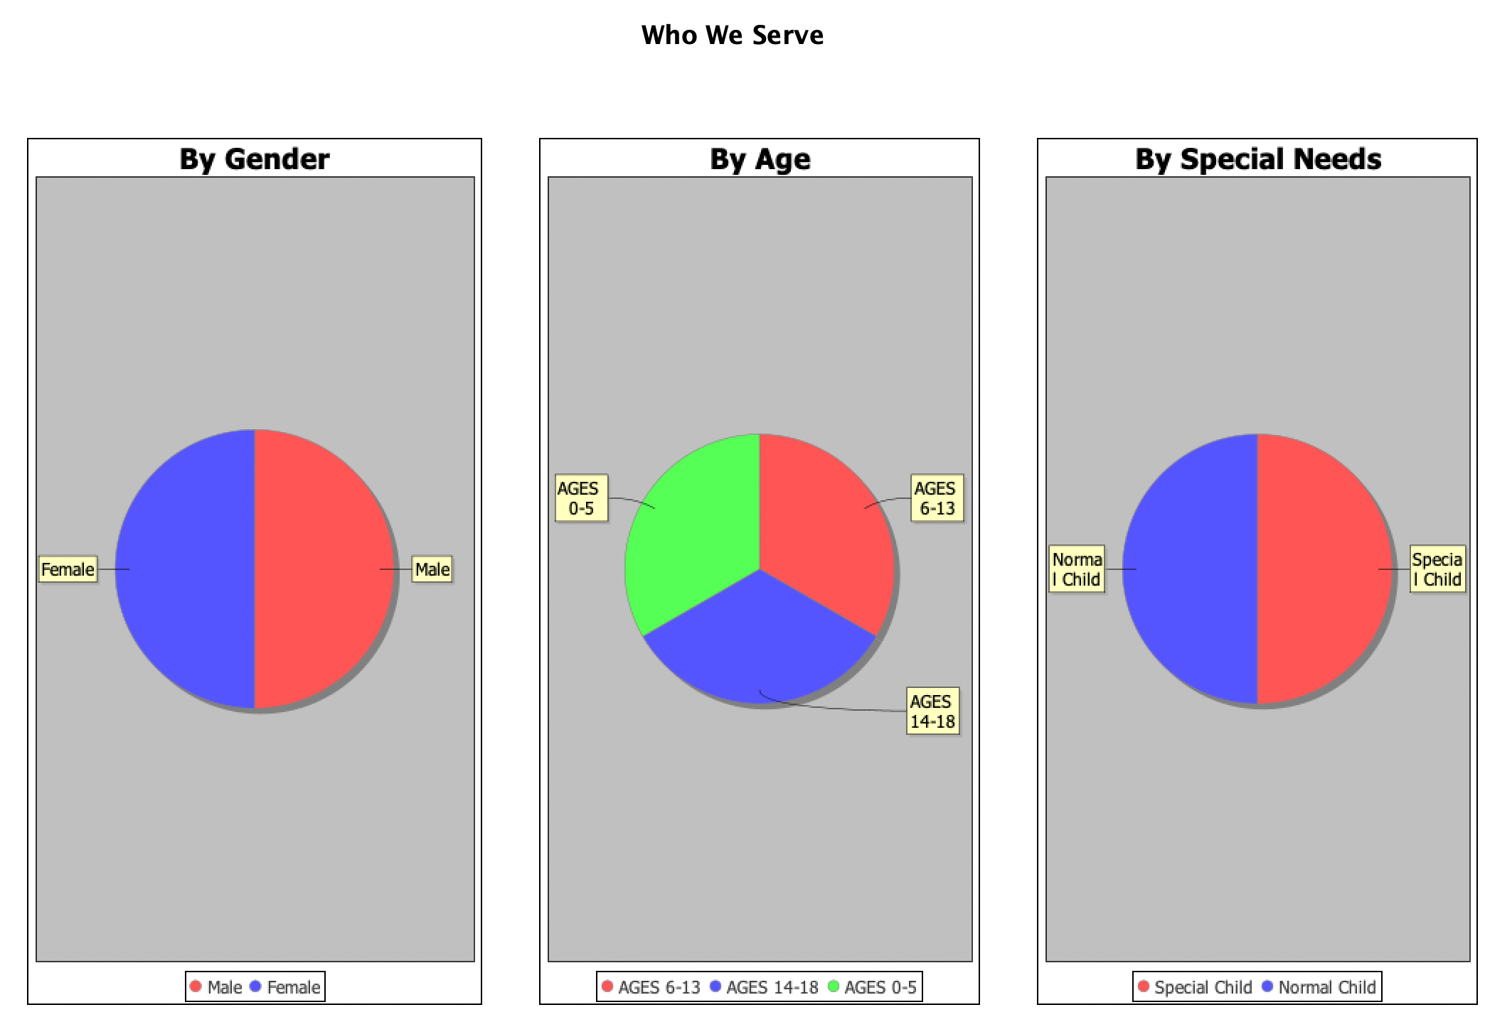
WHO WE SERVE

Slide 11
FLOWCHART

Slide 12
OBJECT MODEL DIAGRAM

Slide 13
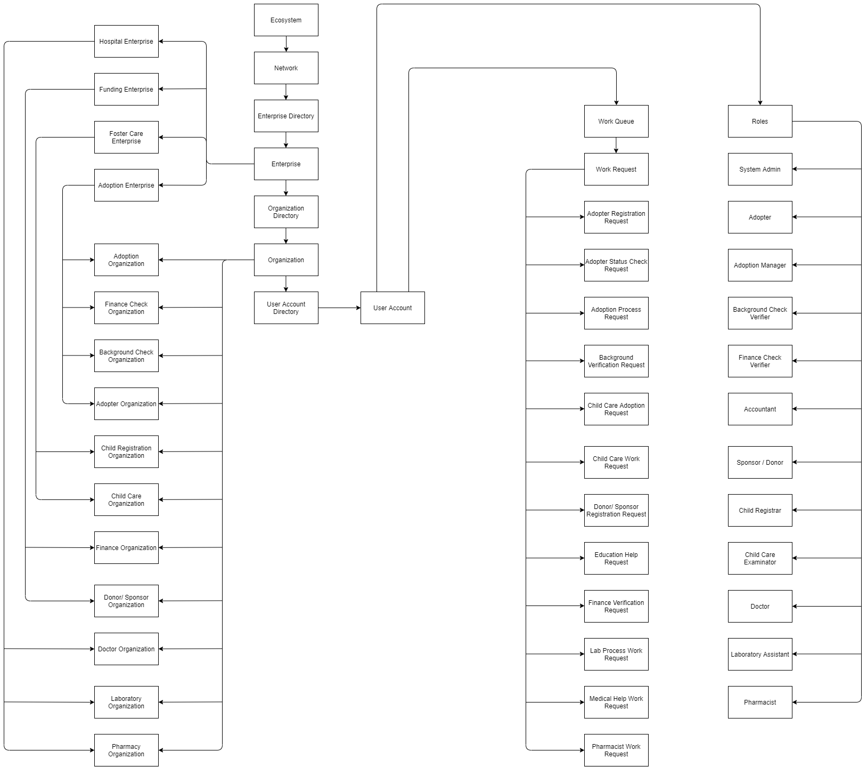

Slide 14
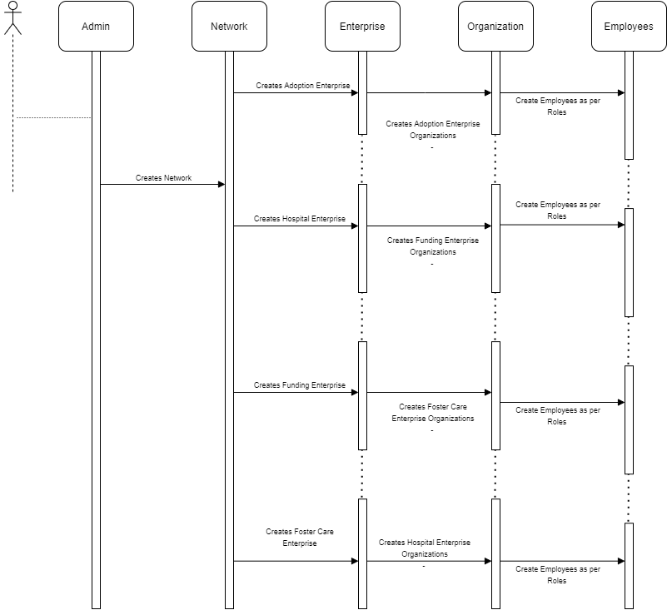
SEQUENCE DIAGRAM

Slide 15
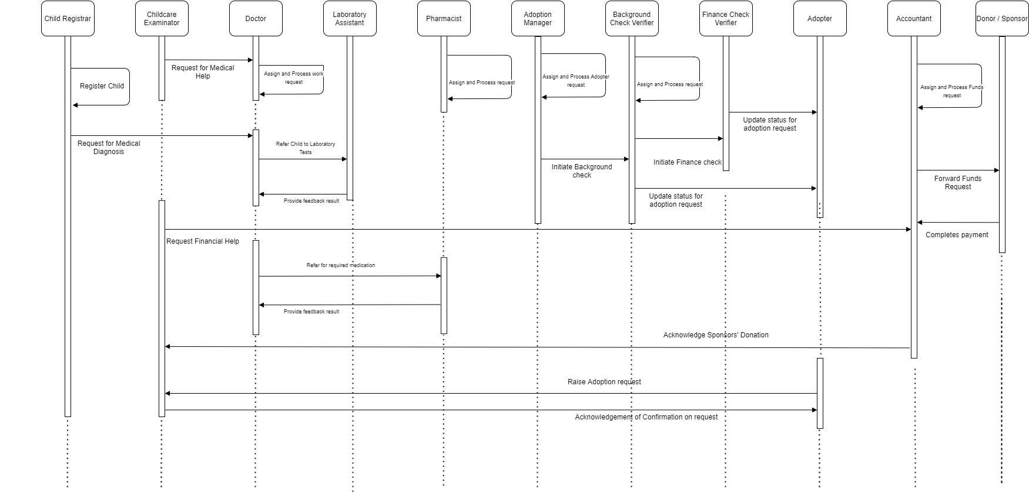

Slide 16

Foster Care - Roles
Child Registrar – Responsible for registering child information in the system
Childcare examinator – Responsible for acquiring child and raise request for medical and financial help as and when required

Slide 17

Hospital - Roles
Doctor – Responsible for diagnosis of child and prescribe medication or refer to laboratory test, if required
Laboratory Assistant – Responsible for performing required tests as per doctor’s recommendation
Pharmacist – Responsible for processing medicine requests as per doctor’s prescription

Slide 18
Funding -Roles
Accountant - Responsible for facilitating childcare monetary requests to sponsors and provide confirmation after receiving payments
Sponsor – Responsible for sponsoring children education, medical needs, living expenses

Slide 19
Adoption - Roles
Adoption Manager – Responsible for initiating background and criminal checks of adopters
Background and criminal check – Responsible for verifying and updating background and criminal checks of adopters
Finance Check - Responsible for verifying and updating financial position of adopters

Slide 20
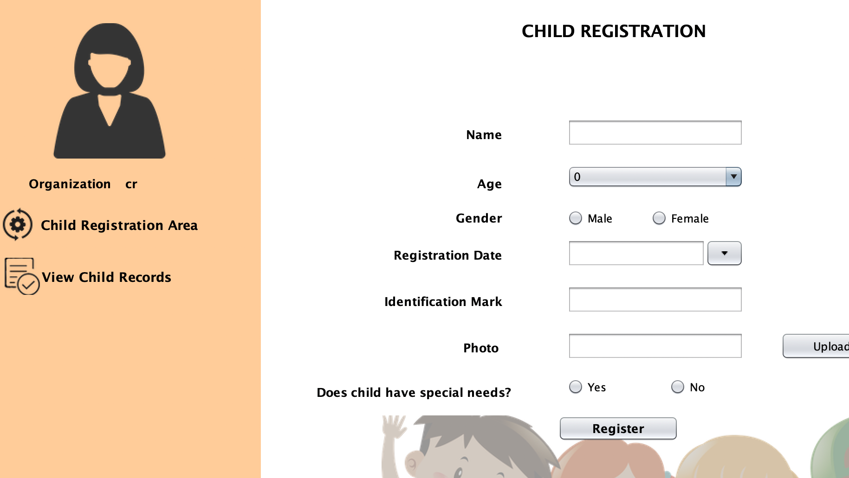
CHILD REGISTRATION ORGANIZATION

Slide 21
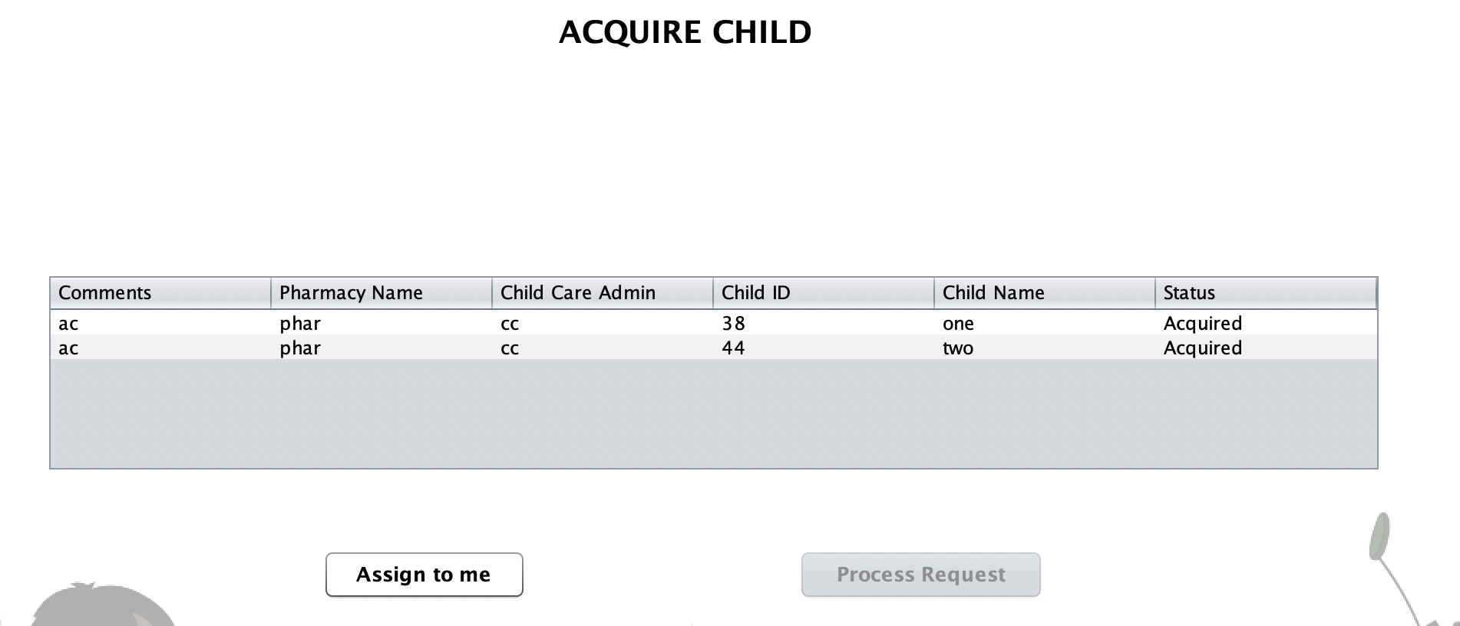
CHILD CARE ORGANIZATION

Slide 22
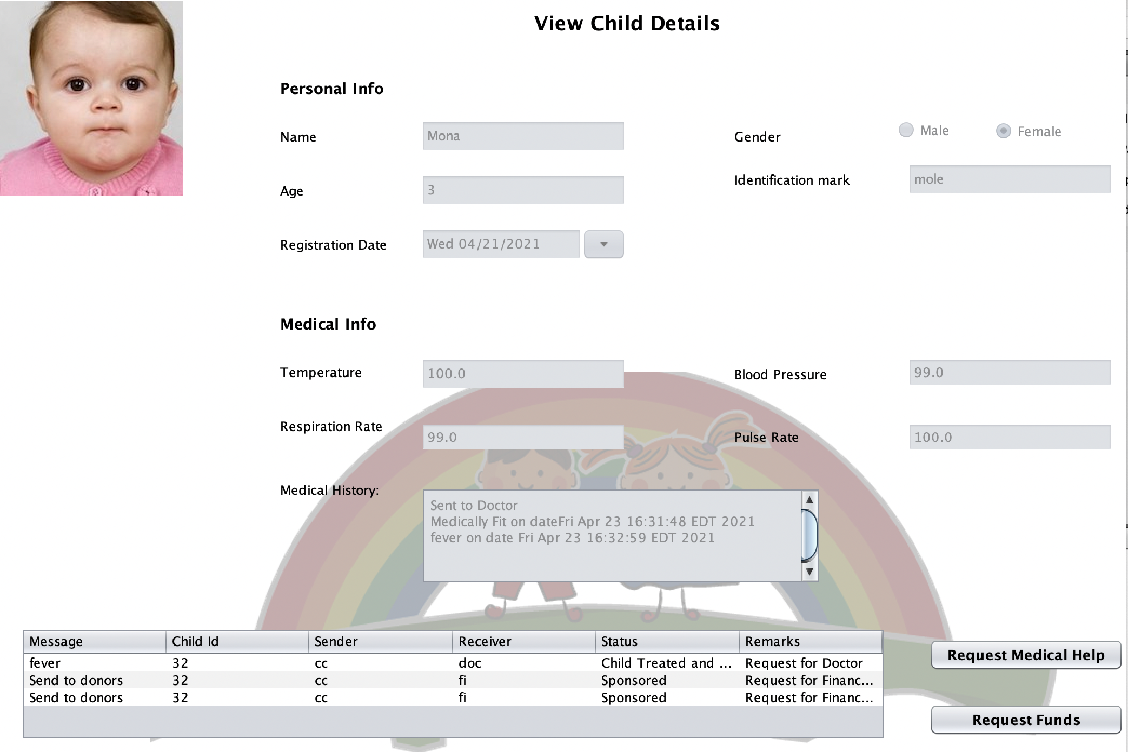
CHILD CARE ORGANIZATION

Slide 23
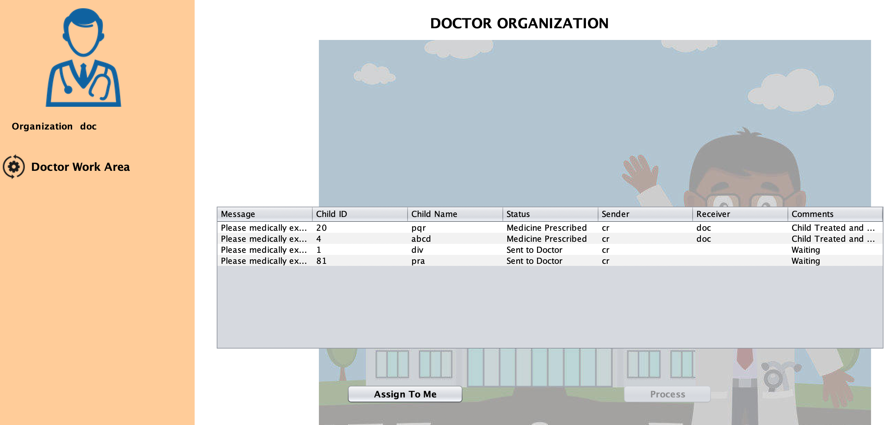
DOCTOR ORGANIZATION

Slide 24
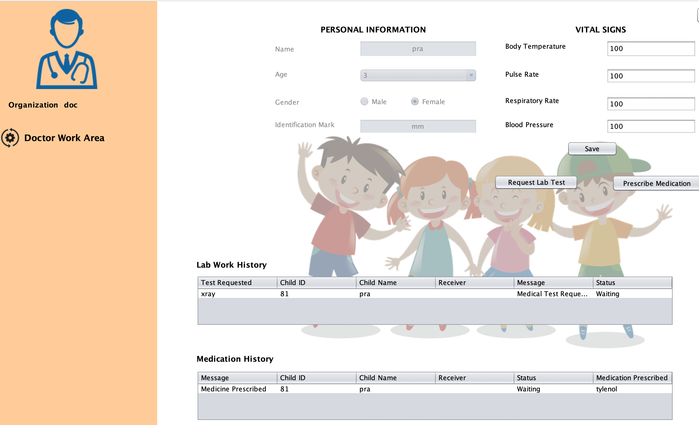
DOCTOR ORGANIZATION

Slide 25
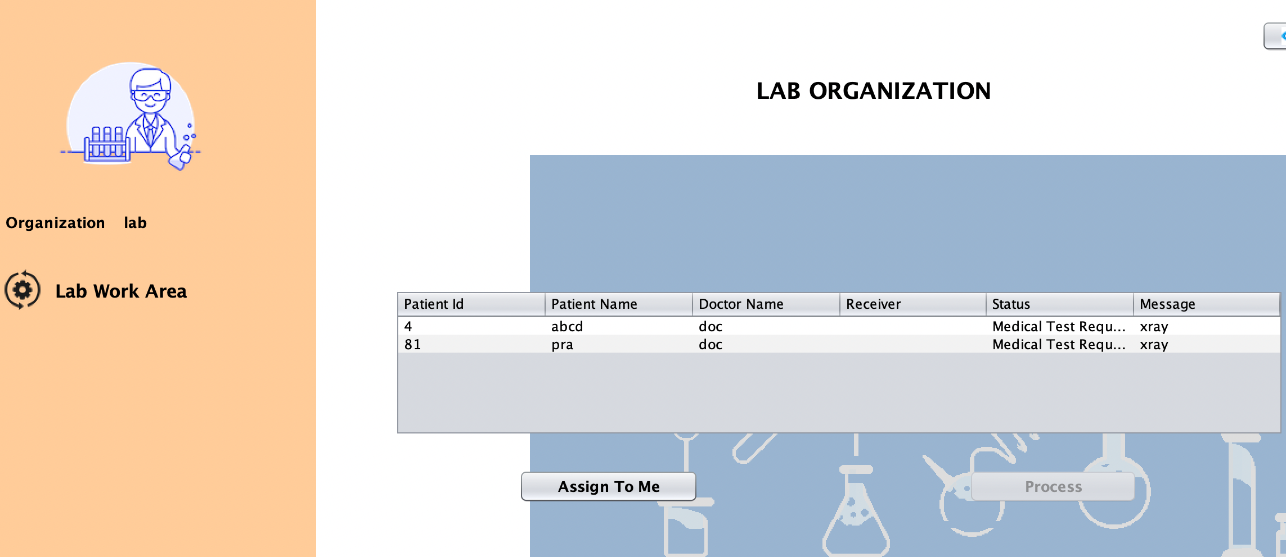
LAB ORGANIZATION

Slide 26
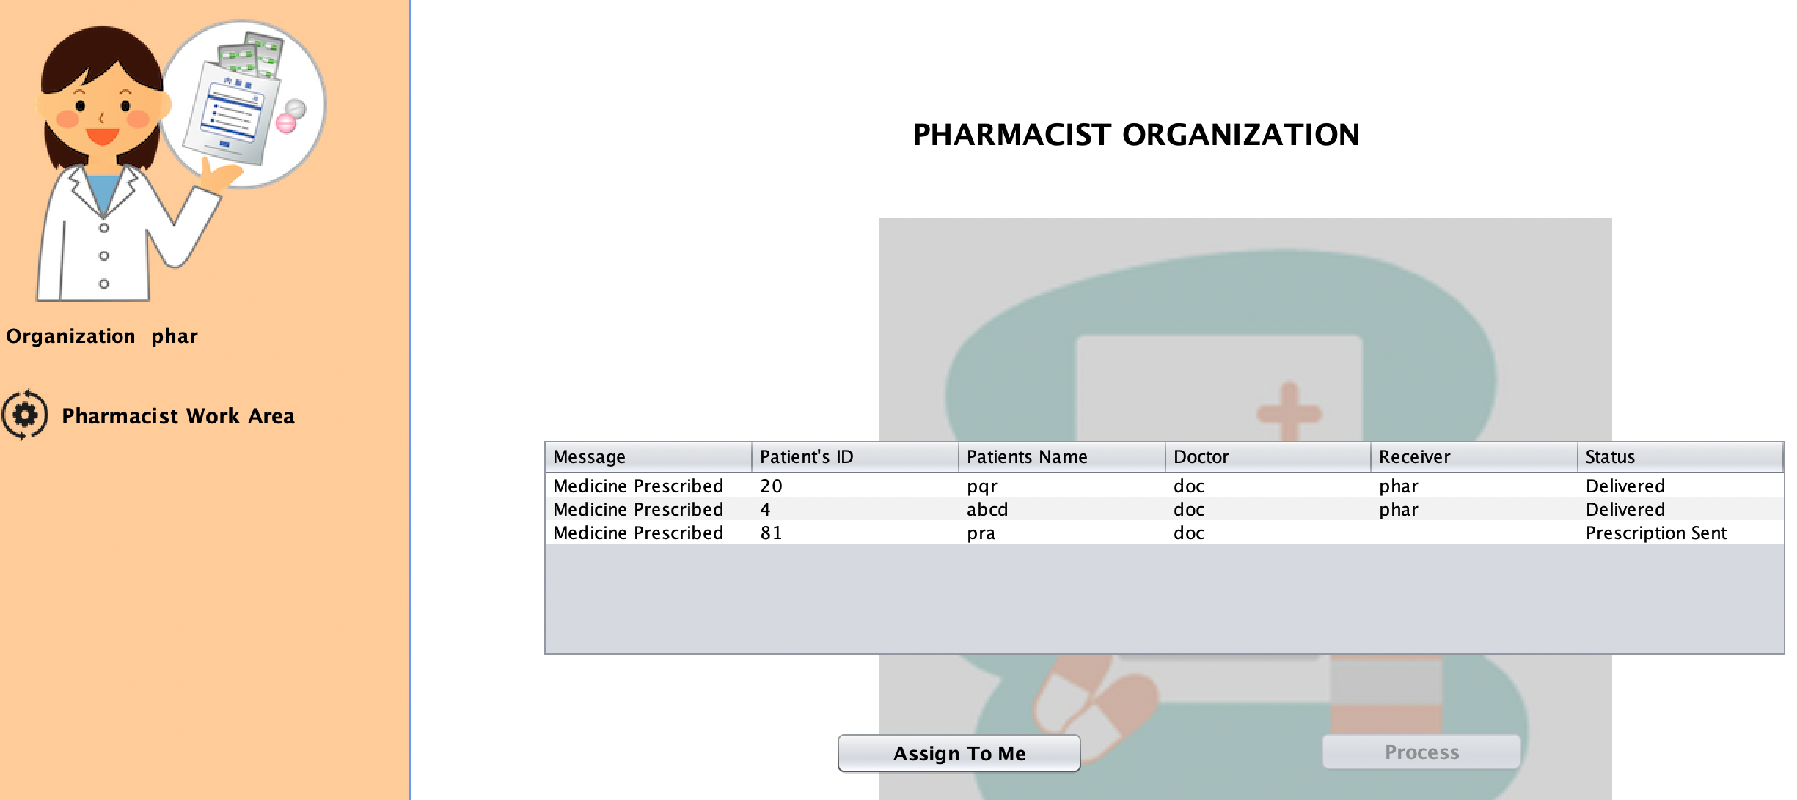
PHARMACIST ORGANIZATION

Slide 27
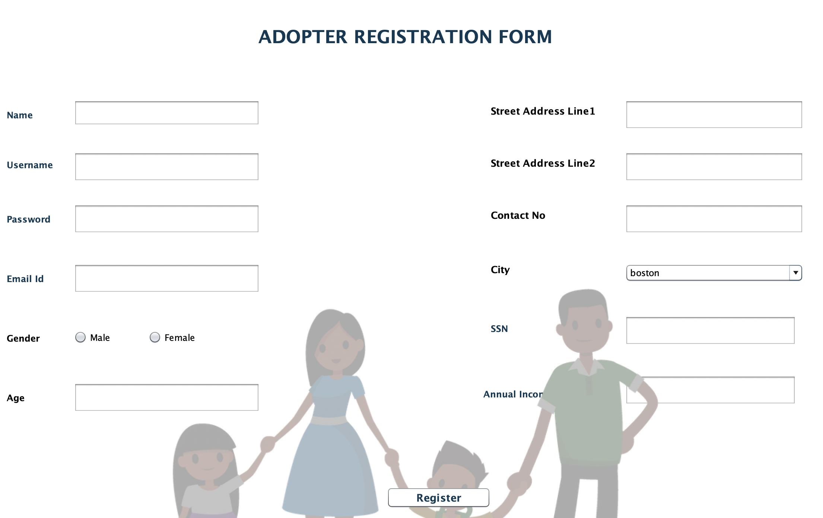
ADOPTION REGISTRATION FORM

Slide 28
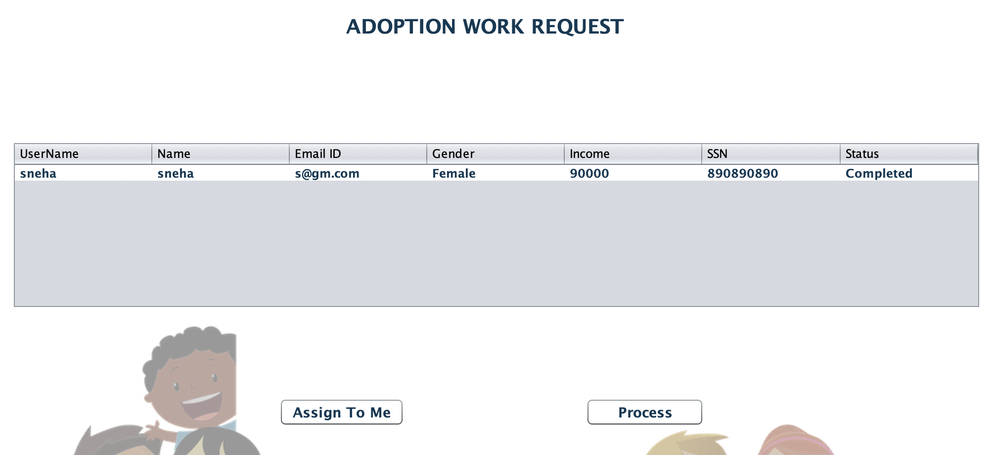
ADOPTION ENTERPRISE APPROVAL

Slide 29
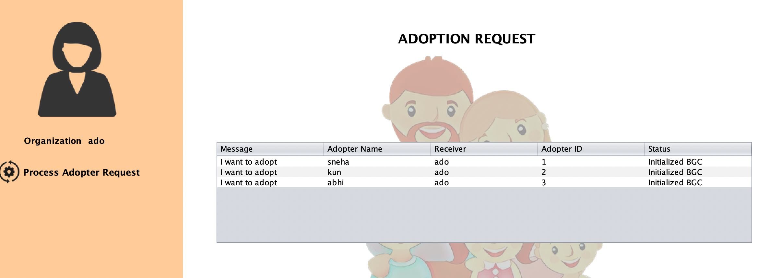
ADOPTION ORGANIZATION

Slide 30
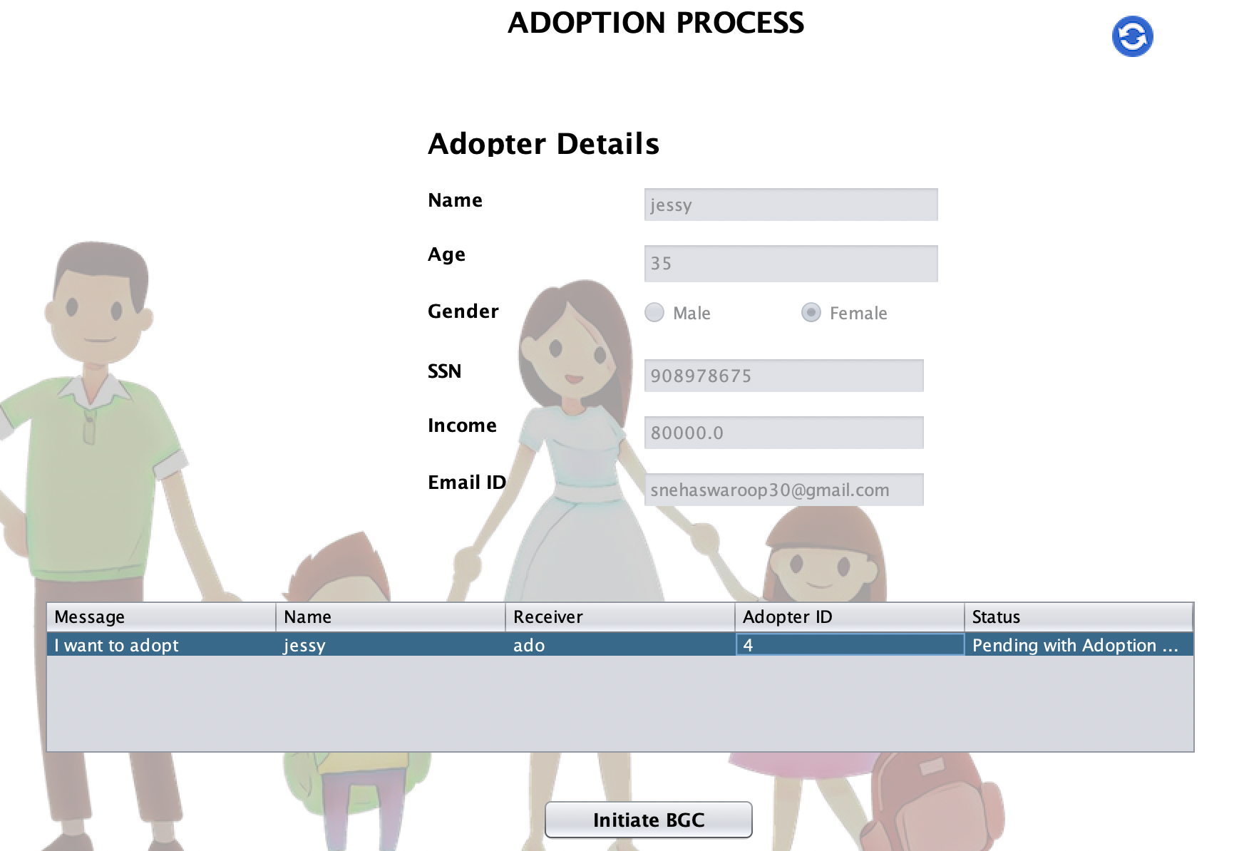
INITIATE BGC

Slide 31
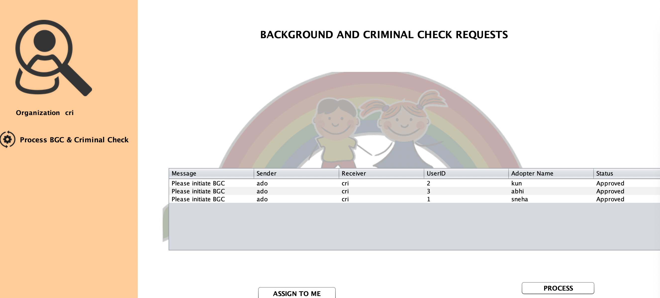
BACKGROUND AND CRIMINAL CHECK ORGANIZATION

Slide 32
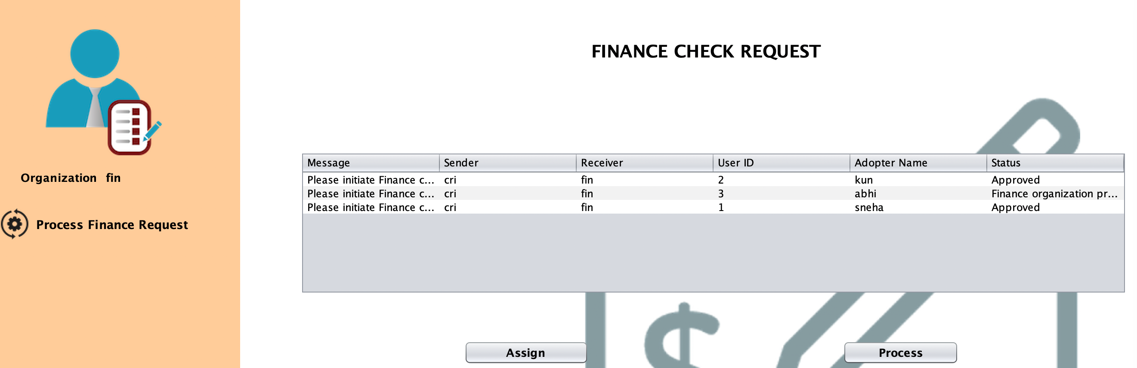
FINANCE CHECK ORGANIZATION

Slide 33
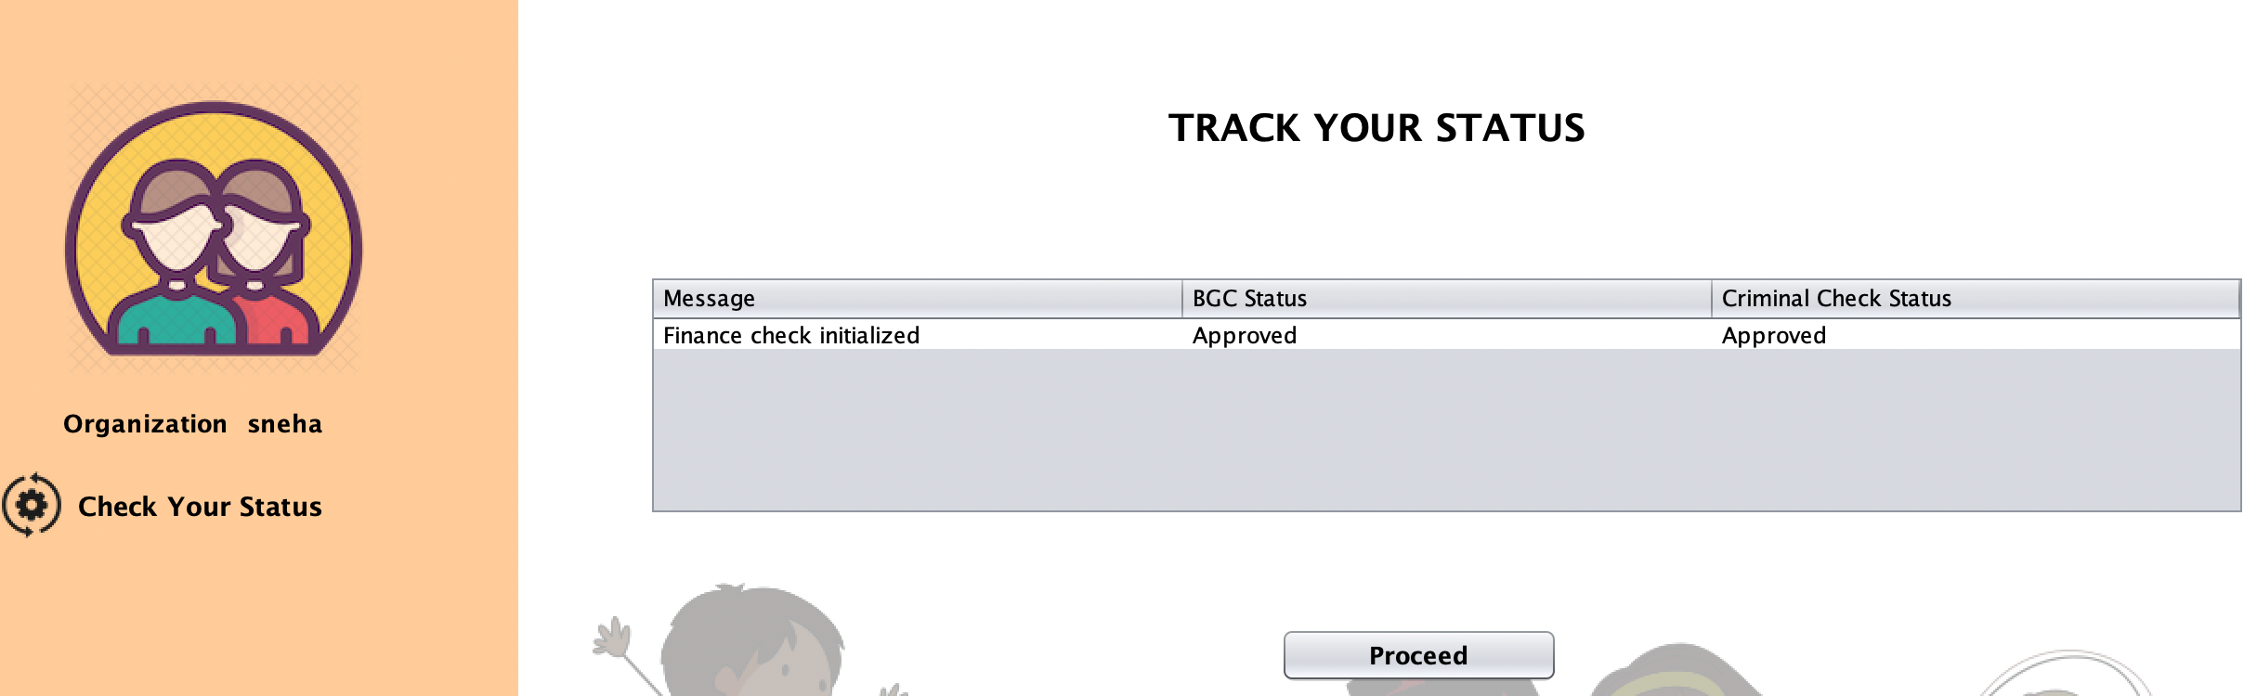
ADOPTER ORGANIZATION

Slide 34
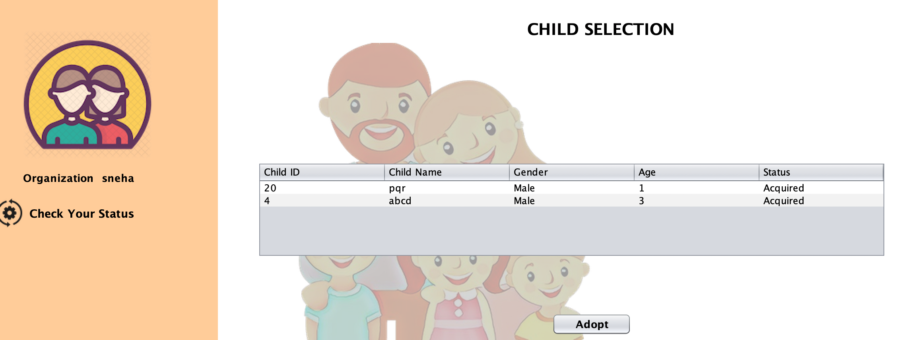
CHILD SELECTION

Slide 35
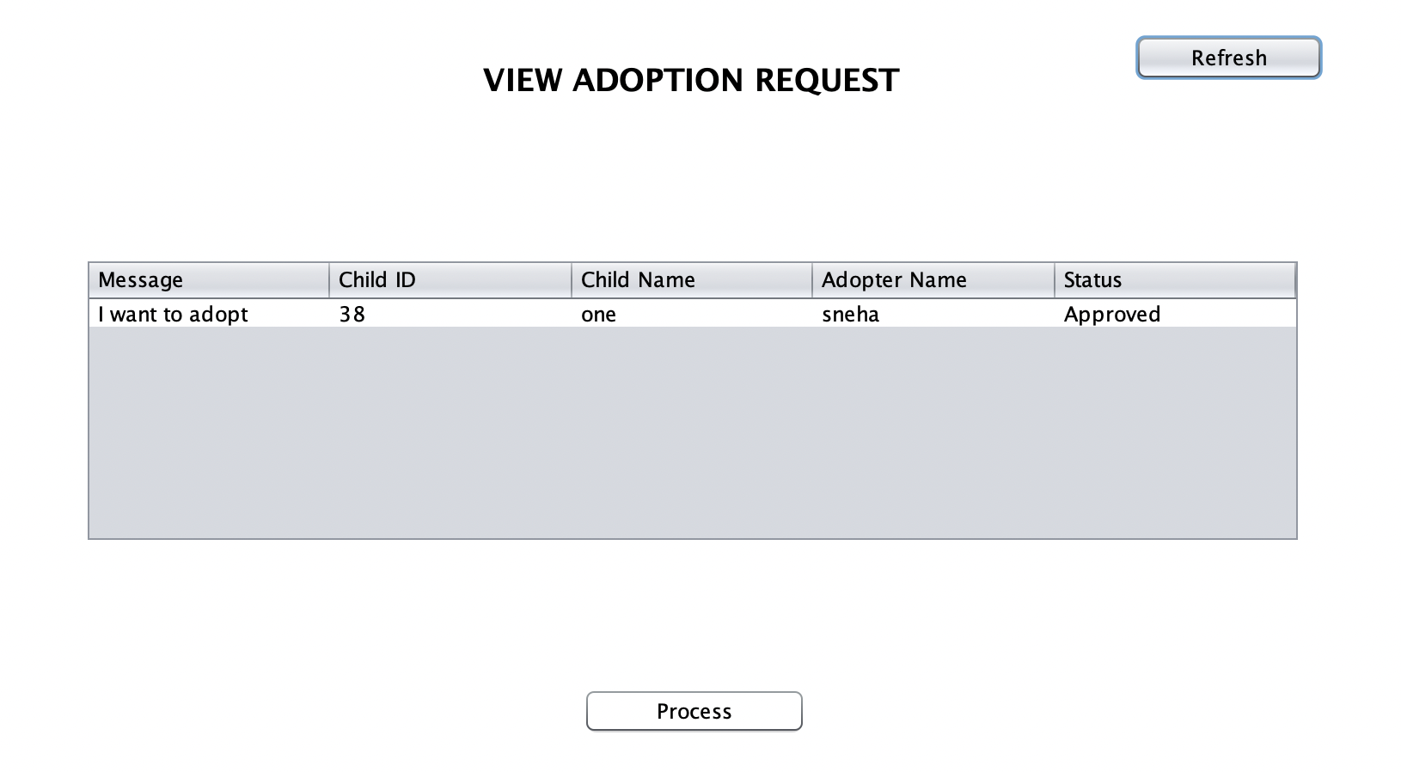
CHILD CARE ORGANIZATION ROLE IN ADOPTION

Slide 36
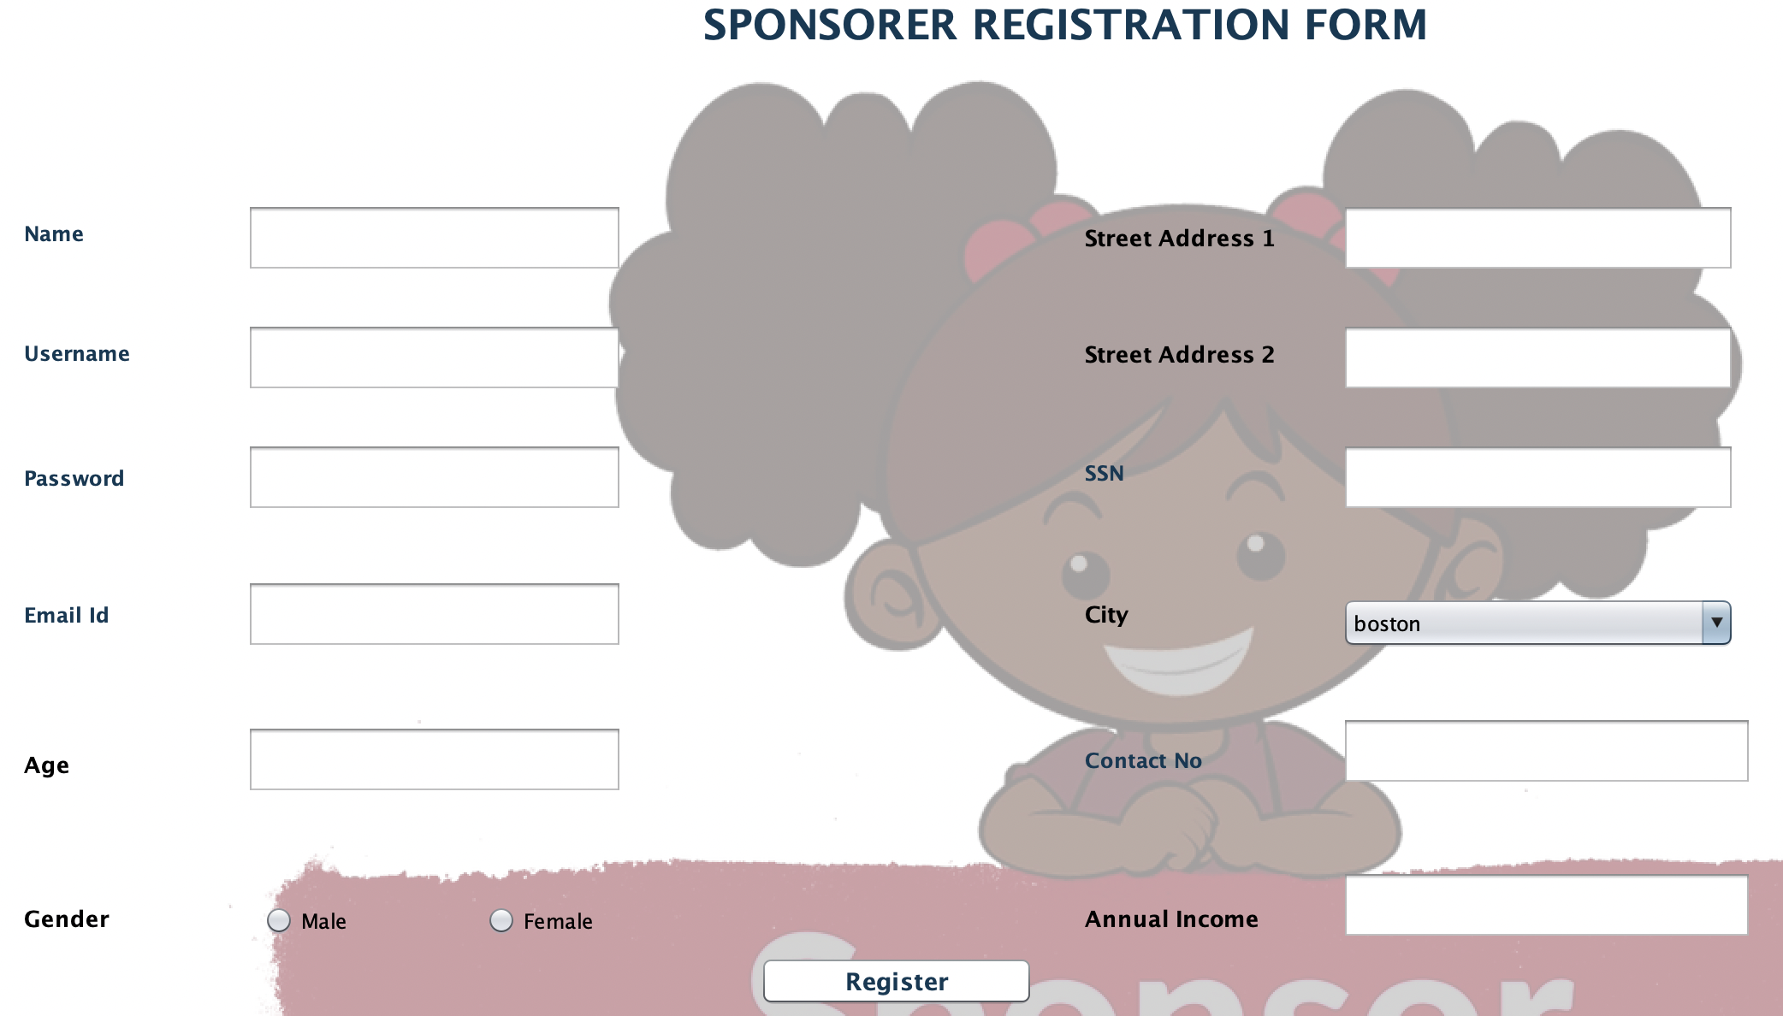
SPONSOR REGISTRATION

Slide 37
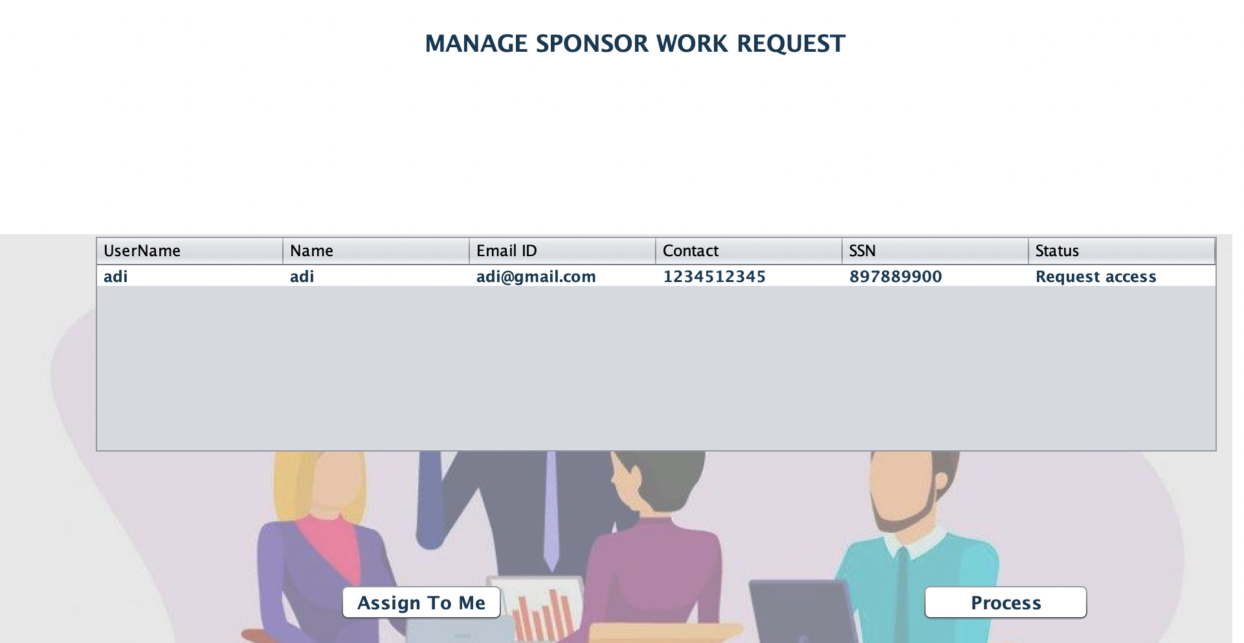
FUNDING ENTERPRISE APPROVAL

Slide 38
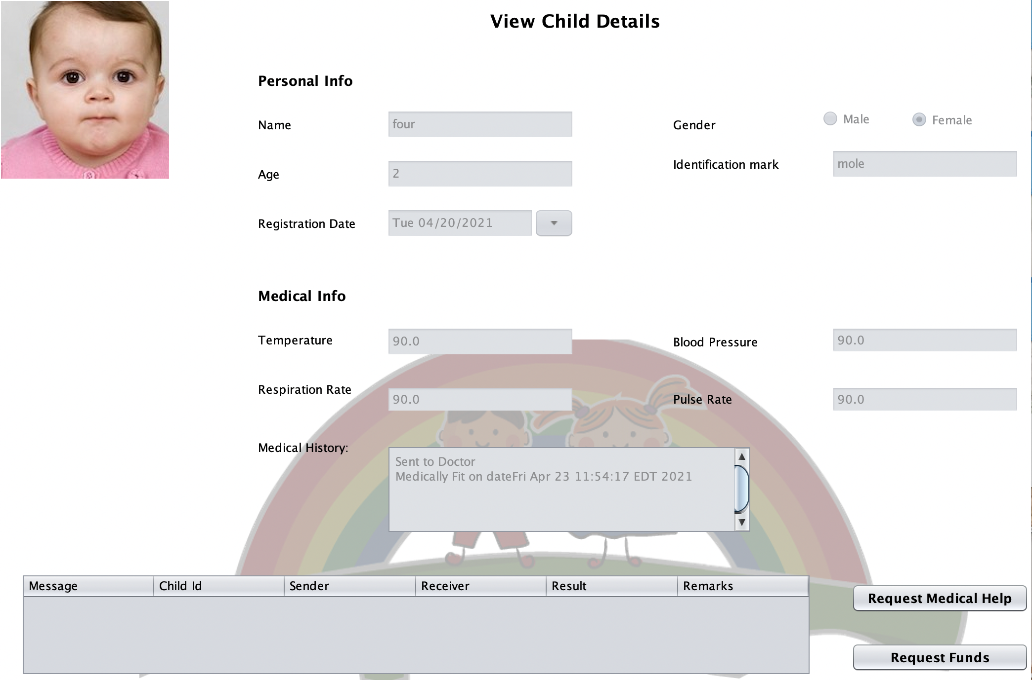
CHILD CARE REQUEST FOR FUNDS

Slide 39
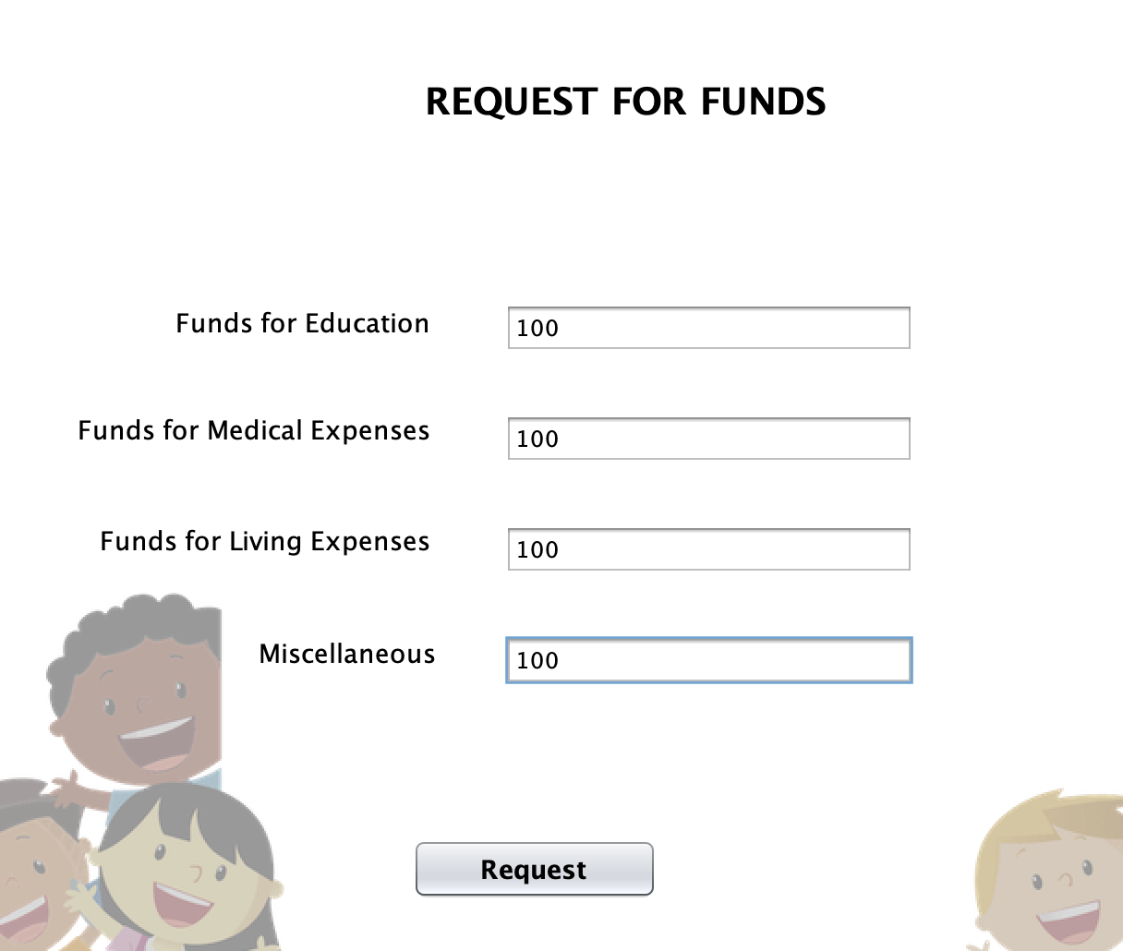
CHILD CARE REQUEST FOR FUNDS

Slide 40
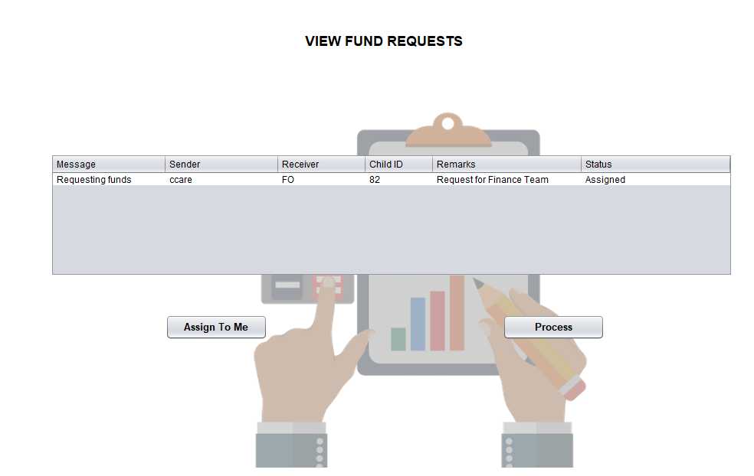
ACCOUNTANT WORK AREA

Slide 41
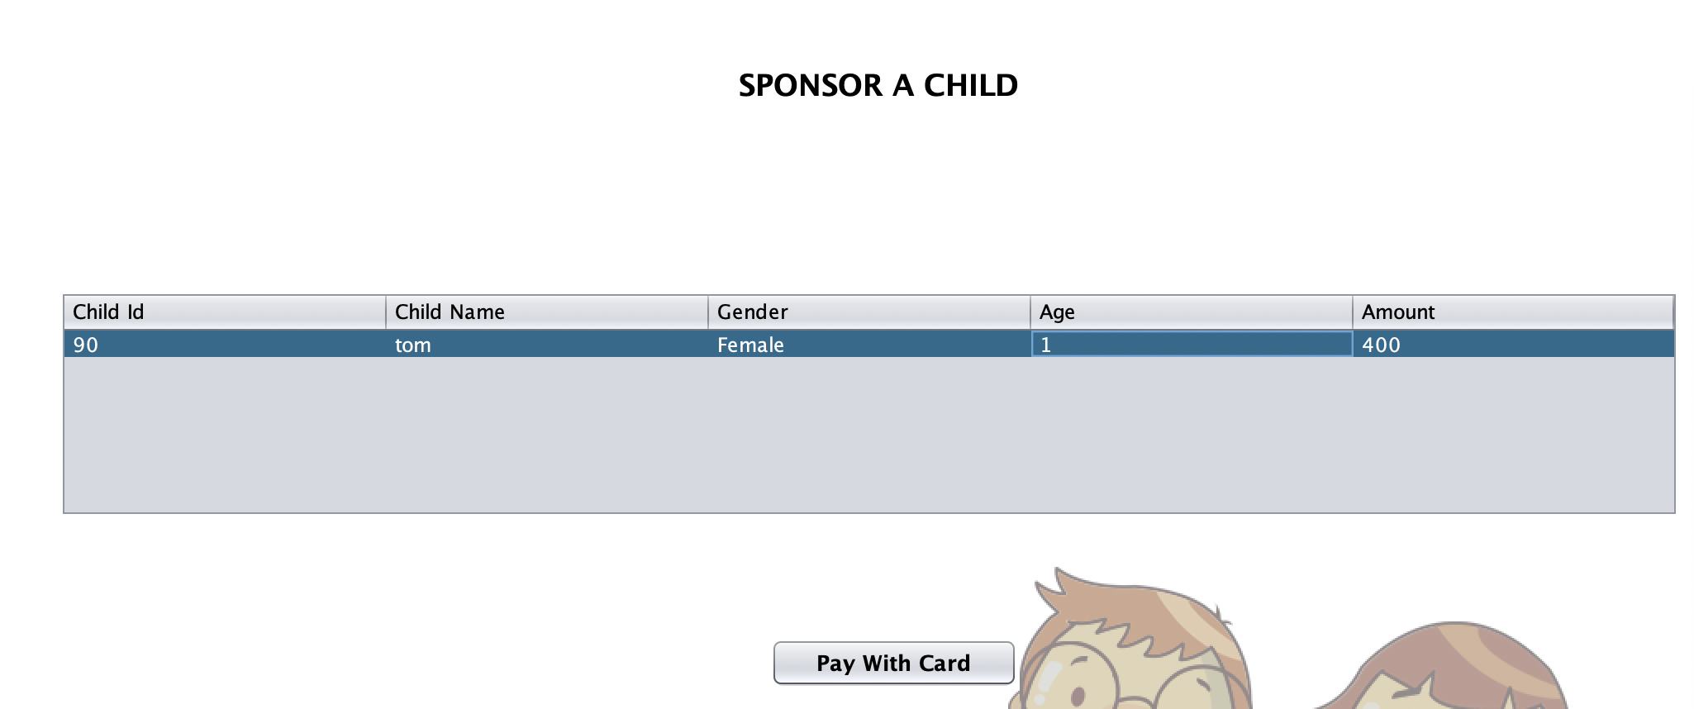
SPONSOR WORK AREA

Slide 42
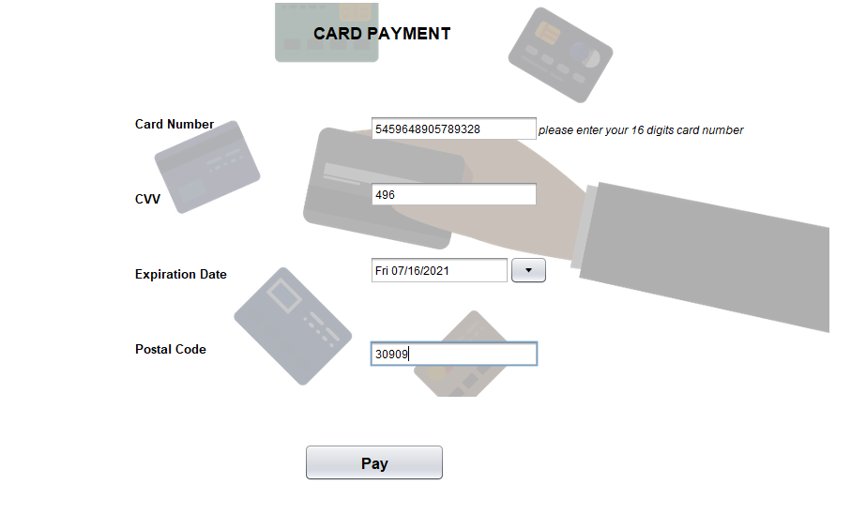
SPONSOR WORK AREA

Slide 43
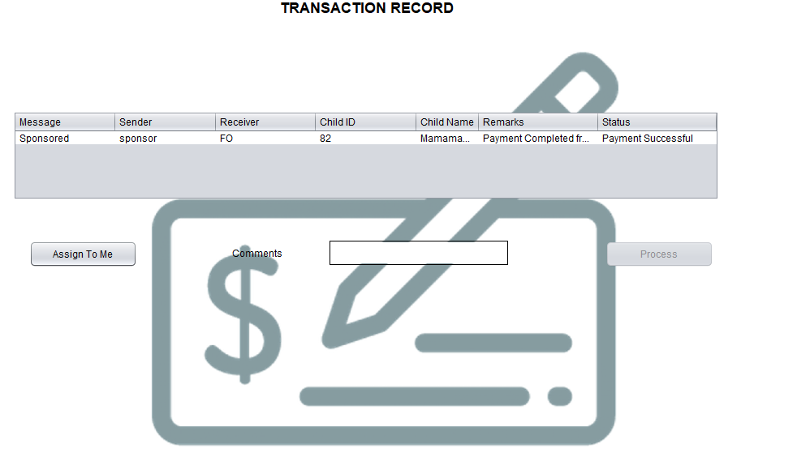
ACCOUNTANT TRANSACTION WORK AREA

Slide 44
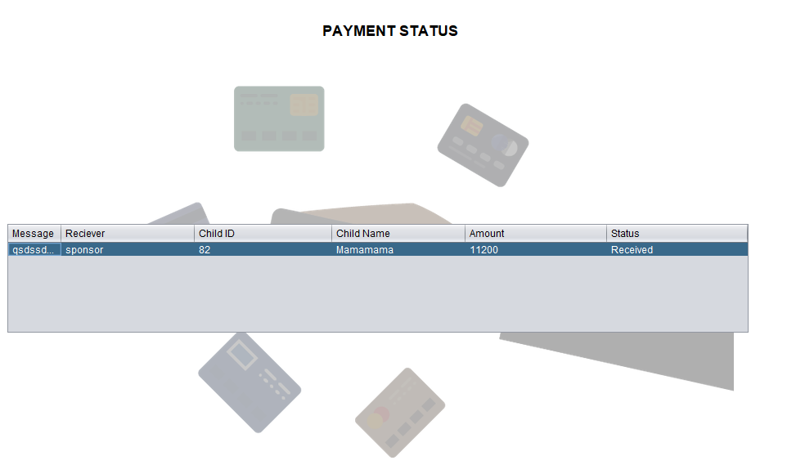
SPONSOR WORK AREA

Slide 45
THANK YOU!

